Slide 1

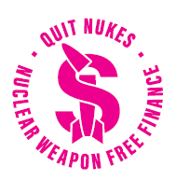

Nuclear Weapons
Think global – act local
Margaret Beavis
Notes:
Thx and ack country

Slide 2
Why worry?
Known multiple “near misses” from human and technical error
Fading concern given other growing catastrophic risks:
e.g. Climate change, pandemics, advances in AI
Not to mention Gaza and other conflicts, cost of living pressures…etc.
https://www.chathamhouse.org/2014/04/too-close-comfort-cases-near-nuclear-use-and-options-policy
https://icanw.org.au/wp-content/uploads/ICAN-Nuclear-weapons-and-our-climate-web-pages.pdf
https://www.sipri.org/publications/2024/sipri-background-papers/nuclear-weapons-and-artificial-intelligence-technological-promises-and-practical-realities
Notes:
Evidence from many declassified documents, testimonies and interviews suggests that the world has, indeed, been lucky, given the number of instances in which nuclear weapons were nearly used inadvertently as a result of miscalculation or error.

Slide 3
But wait, there’s more
Rising geopolitical rivalries, unpredictable leaders and a climate stressed world means worsening conflicts.
Recent conflicts - since May 2025:
India and Pakistan traded air strikes
Ukraine drone attack destroyed Russian nuclear capable bombers
Israel bombed Iran’s nuclear facilities
Every day without nuclear war is a lucky day.

Slide 4
Nuclear Weapons - Current state of play
About12,300 now
Total yield is much bigger = 146,605 Hiroshima bombs.
“Low yield” = 30 Kt i.e. twice the size of Hiroshima bomb.
Htt
Wargaming Nuclear Deterrence and Its Failures in a U.S.–China Conflict over Taiwan
https://www.csis.org/analysis/confronting-armageddon
ps://www.mja.com.au/journal/2025/222/11/ending-nuclear-weapons-they-end-us
Notes:
from their 1986 peak of 70 300,

Slide 5
Decade long climate impacts
The global climate disruption caused by the smoke
pouring from cities ignited by just 2% of the current arsenal
could result in over two billion people starving.

Slide 6
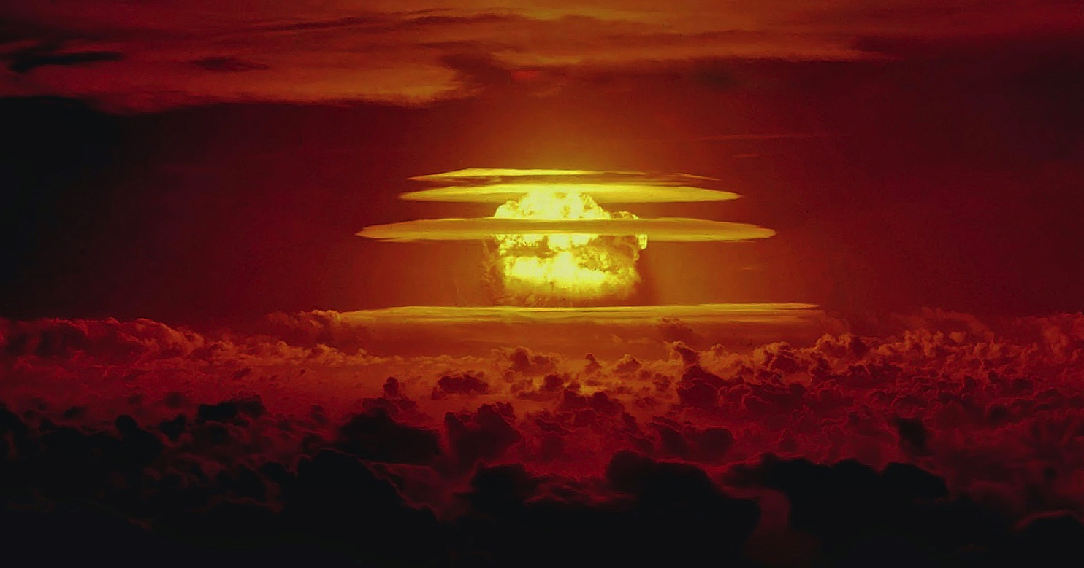
- 15 kt explosion Hiroshima: 13 km² burned
- 5 Mt explosion on a city: 1600 km² will burn in firestorm; more in a conflagration Slide Tilman Ruff
Notes:
6
While a tiny fraction of their arsenals coulda global nuclear famine, a large scale war between them involving just the 1550 weapons each is allowed when New START os fully implemented might cause the extinction of our species.

Slide 7
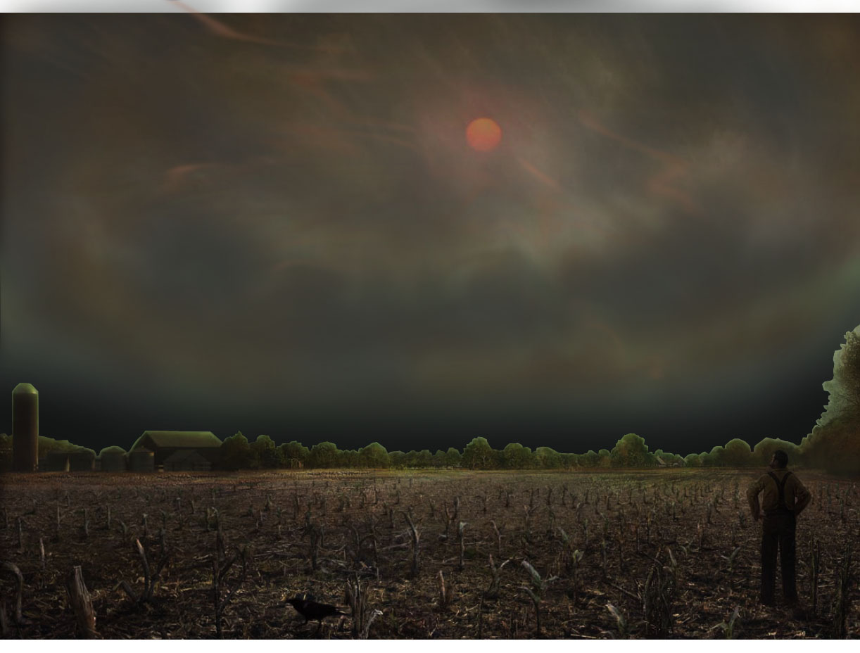
Nuclear Winter
Cold, dry, dark, and more UV
Crops dying and global famine
© 2009 Scientific American Inc

Slide 8
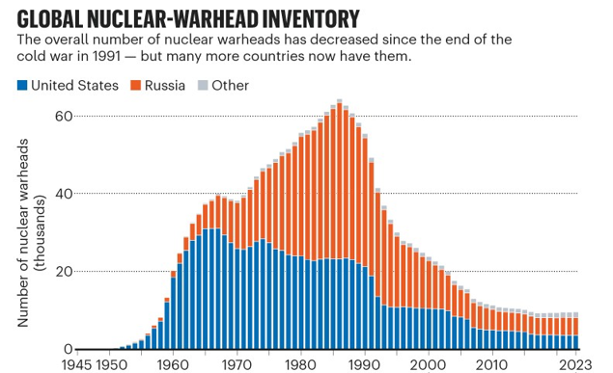
The Bulletin of the Atomic Scientists’ Nuclear Notebook (go.nature.com/4JQYHWT)

Slide 9
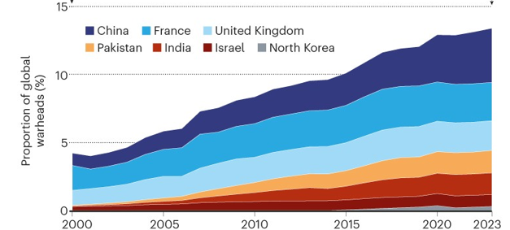
Outside US &UK arsenals
The Bulletin of the Atomic Scientists’ Nuclear Notebook (go.nature.com/4JQYHWT)

Slide 10
A worldwide nuclear arms race is underway.
China, India, North Korea, Pakistan, Russia and the UK are all enlarging their arsenals.
2011 New START treaty expires in February 2026, UK and US will no longer have numerical limits on their nuclear forces (first time since the 1970s).
2,100⁺ nuclear warheads are on high alert.
https://www.nature.com/articles/d41586-023-00679-w
Notes:
-High alert weapons in France, Russia, the UK, the United States and, for the first time, also in China.
Strategic Arms Reduction Treaty, or

Slide 11
Heading in the wrong direction
Extensive nuclear modernisations are underway,
Nuclear‐armed Russia and Israel engaged in active wars involving repeated nuclear threats,
Russia and the US deploying nuclear weapons to additional states,
Widespread use of cyberwarfare.
The risk of nuclear war is greater than ever.

Slide 12
What is unrealistic?
Nihon Hidankyo was awarded the Nobel Peace Prize last year.
Nobel Committee Chair Jørgen Watne Frydnes noted:
“It is naive to believe our civilisation can survive a world order in which global security depends on nuclear weapons.
The world is not meant to be a prison in which we await collective annihilation.”
https://www.nobelpeaceprize.org/getfile.php/137197-1733759231/_Dokumenter/Presse/2024/Presentation_Speech_2024.pdf

Slide 13
After World War II, a global movement arose
Gradually, an international norm developed that stigmatised the use of nuclear weapons as morally unacceptable.
Like other international norms, the nuclear taboo is maintained by collective agreement – by widespread moral outrage at the prospect of using nuclear weapons, and by a mutual fear of the abyss awaiting humanity if the norm is violated.
The only way to protect against the horrendous impacts from nuclear weapons and nuclear war is to abolish them once and for all.

Slide 14
Working for a nuclear weapons free future
Public pressure creates treaties
- which have real world impacts
1950s limited nuclear weapons testing
1980s worldwide campaigns led to reduced global nuclear arsenals
2000s global civil society effort made nuclear weapons finally illegal under international law with the UN Treaty on the Prohibition of Nuclear Weapons (TPNW)

Slide 15
What can we do ?
Disarmament needs insistent public appeals and sustained pressure.
Lobby government to sign the TPNW
ALP policy since 2018, some positive steps
75% of Australians want us to sign treaty
We would be the first “Nuclear Umbrella” state to do so

Slide 16
Send an email/ letter to the PM and FM – ask them to sign the treaty now.
Contact your federal MP –ask them to sign ICAN pledge, and govt sign treaty now.
Tools: ICAN Australia Website – Action
https://icanw.org.au/pledge/
https://actionnetwork.org/letters/pm-fm-2025?source=direct_link&

Slide 17
Is your local council on board?
ICAN Cities Appeal is a global call from cities and towns in support of the UN Treaty on the Prohibition of Nuclear Weapons.
Over 50 councils have joined the Cities Appeal- including every state capital.
See if your local council has signed on
https://icanw.org.au/cities/
If not- contact your councillor or mayor.

Slide 18
Are you funding nuclear weapons companies with your Super?
Most MySuper fund options hold nuclear weapons companies
Notable exceptions include Australian Ethical, HostPlus and Vanguard
Funds have multiple excuses:
A big one is members don’t care about it.
Email your fund and ask if they have NW companies in any part of their portfolios. (they will try to fob you off with the ethical fund options)
If they do have nukes, tell them what you think! Reputation matters…
https://quitnukes.org/
Notes:
S o u t h K o r e a , J a p a n , a n d P a k i s t a n h a v e a l l e x p r e s s e d i n t e r e s t i n n u c l e a r - p o w e r e d s u b m a r i n e s . W o r r y i n g l y ,
a n d h e r e i n l i e s t h e p r o b l e m i n i t s s t a r k e s t f o r m , I r a n h a s i n f o r m e d t h e I A E A t h a t i t i n t e n d s a t
s o m e u n s p e c i f i e d t i m e t o a c q u i r e s u c h a
c a p a b i l i t y ,

Slide 19
Keeping Australia Nuclear Weapons Free
Malcolm Fraser refused to have nuclear weapons on Australian soil.
So:
Any B-52’s based in Australia must not be nuclear weapons capable.
Military exercises should not pre-position US missile systems and weapons stockpiles- eg Typhon missile systems
Visiting submarines should be explicitly banned from carrying nuclear weapons in our ports.
Pine Gap should not be used for nuclear weapons targeting.
https://nautilus.org/briefing-books/australian-defence-facilities/nuclear-capable-b-52h-stratofortress-bombers-project/ Jorgen Doyle https://militarisminthent.substack.com/

Slide 20
And of course
Oppose AUKUS subs
Increases risk of regional conflict
Transfer of weapons grade HEU to a non-nuclear armed state sets a terrible precedent- other countries now interested
“Safeguards” impossible to enforce
Breaches Fissile Material Cut-off Treaty.
Waste nuclear weapons grade material
So flawed on so many other levels as well…
Notes:
S o u t h K o r e a ,
J a p a n , a n d P a k i s t a n h a v e a l l e x p r e s s e d i n t e r e s t
i n n u c l e a r - p o w e r e d s u b m a r i n e s . W o r r y i n g l y ,
a n d h e r e i n l i e s t h e p r o b l e m i n i t s s t a r k e s t f o r m ,
I r a n h a s i n f o r m e d t h e I A E A t h a t i t i n t e n d s a t
s o m e u n s p e c i f i e d t i m e t o a c q u i r e s u c h a
c a p a b i l i t y ,

Slide 21
Nuclear war and Pine Gap
is critical for US nuclear war-fighting plans and operations, as well as for conventional operations around the world;
automatically pulls Australia into US planning for war with China;
renders Australia complicit in gross violations of international law; and
means that Alice Springs is a priority nuclear target in the event of full-scale war.
                Prof Richard Tanter March 2025

Slide 22
So- a few actions to chose from…
Contact Albo and Penny Wong - sign the TPNW
Contact your MP- Pledge to sign the TPNW
See if your council is part of the Cities Appeal
Make some noise with your super fund
https://icanw.org.au/action/
Continue to oppose AUKUS
Lobby for Australia to be nuclear weapons free

